Slide 1
Cryptography
Lec04–Cryptography
Prepared by Saadia Aziz © 2020 saadia aziz saadia.aziz@riphah.edu.pk

Slide 2
Caesar Cipher
Caesar cipher, also known as Caesar's cipher, the shift cipher, Caesar's code or Caesar shift discovered by Julius Caesar.
It is type of Substitution Cipher in which each letter in the plaintext is replaced by a letter of some fixed number of positions in the set of alphabets
It is most simplest cipher
Firstly it was used in military affairs as an encryption algorithm

Slide 3
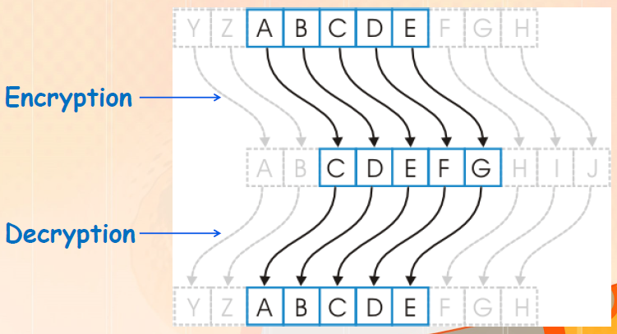
Caesar Cipher: Mathematical Base

Slide 4
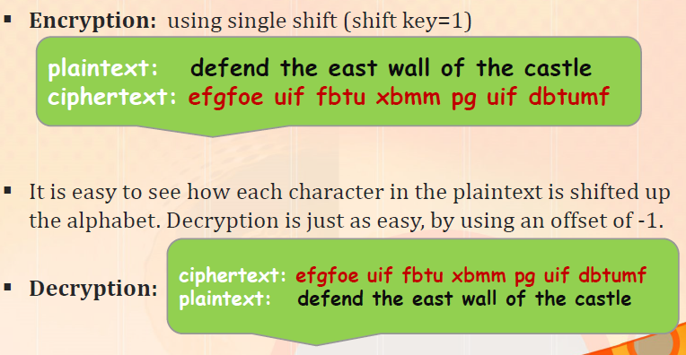
Caesar Cipher: Example

Slide 5
Caesar Cipher Example 2
Using Caesar Cipher, Replaces each letter by 3rd letter on, it means Key = 3
Example:
Plaintext: meet me after the toga party
Cipher-text: PHHW PH DIWHU WKH WRJD SDUWB
M,n,o,p e,f,g,h
1,2,3,.

Slide 6
Weakness of Caesar Cipher
Caesar only has 25 possible keys –far from secure
So,,,,
It can be crack by Guessing key shifts
OR Using all possible case of 26 alphabets (Brute-force attack )
The Solution:
use multiple shift keys. Shift by 3,5 and 7

Slide 7
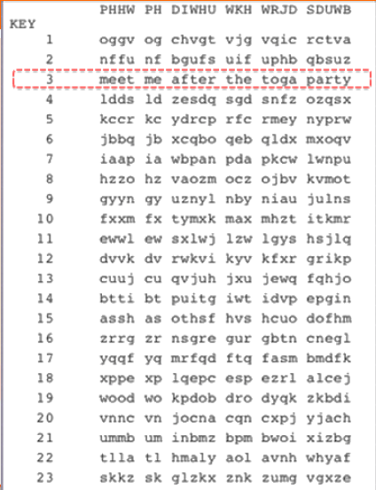
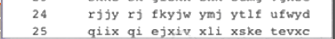
Cracking of Caesar Cipher

Slide 8
Strengthening Caesar: Mono alphabetic ciphers
Caesar only has 25 possible keys –far from secure
Idea: instead of shifting the letters with a fixed amount how about allowing any permutation of the alphabet
Plain: a b c d e f g h I j k L m n o p q r s t u v w x y z
String : D K V Q F I B J W PE S C X H T M Y A U O L R G Z N
Plaintext: if we wish to replace letters
Cipher text: WI RF RWAJ UH YFTSDVF SFUUFYA
This is called mono alphabetic substitution cipher–a single alphabet is used
The increase in the number of keys is dramatically as for each case there is 26 possibilities. i.e., more than 400,000,000,000,000,000,000,000,000 such rearrangements

Slide 9
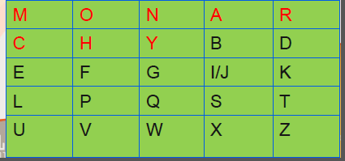
Playfair Cipher
The Playfair Cipher is an example of multiple-letter encryption
Invented by Sir Charles Wheatstone in 1854
Based on any keyword as key to build 5x5 key matrix which is called key matrix, e.g. using the supposed keyword: MONARCHY
Fill rest of matrix with other letters without repeating any letters in
the supposed keyword
Letter are 26 but boxes are
25 that’s why we write i/j
in one box

Slide 10
General Rules For Playfair
General Rules:
if a pair is a repeated letter in plaintext, insert filler like 'X’,
if message is odd, insert letter X
The repeated letter in keyword should be written only once in the key matrix
Any keyword is used to build key matrix as a secret key
Any other related condition(s) related to handling of string can be handled via programming tricks

Slide 11
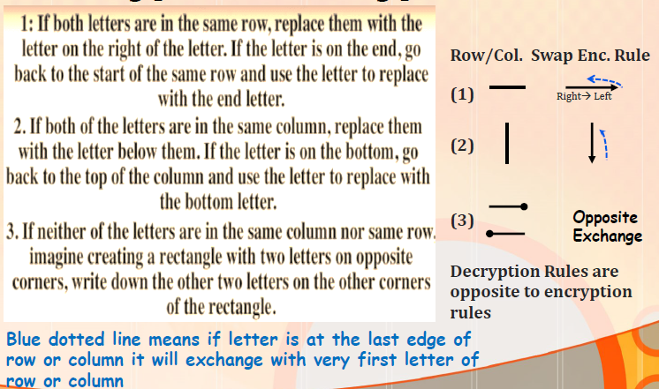
Encryption Decryption Rules

Slide 12
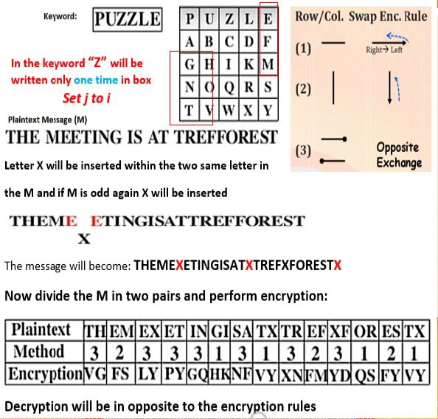
Playfair Encryption Decryption Example

Slide 13
VigenèreCipher
It is a form of polyalphabetic substitution cipher
Invented by Frenchman, Blaise de Vigenère
Remained in secure use up to 200 years
Encryption is based on shifting the letter position alike Caesar cipher using arithmetic function.
Easiest way to handle Vigenère cipher is to use arithmetic modulo 26
This approach dispenses with the need for the table
Decryption is reverse to the encryption process

Slide 14
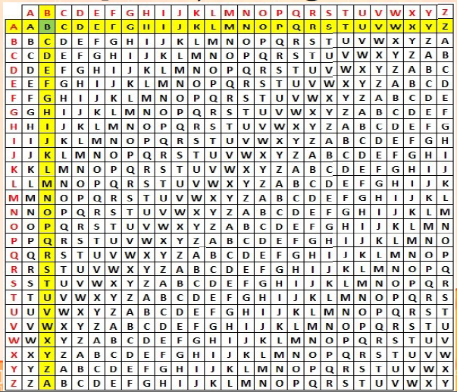
Vigenère square, or Vigenère table

Slide 15
Vigenere Cipher Example
Encrypt Message (M): W E A R E with Key(K): Math using Vigenere Cipher
Message (M): W E A R E (See on the top of table to search w Column)
Key (K): M A T H M (See letter by letter in Row of Vigenere table to select row starting with M)
Ciphertext (C): I E T Y Q
Key (K): M A T H M ( See first letter row of M to find I, then answer can be find on the top of I in very first row)

